Slide 1
topic:Solar vehicle
Name of students:
1)Pratik hardas
2)Nitish deshmukh

Slide 2
introduction
Carbon-based fuels are hazardous to the environment, and there is also a scarcity of carbon-based fuels.
Solar energy is chosen as an alternative since it provides clean, safe, and sustainable energy. Solar energy has innumerable benefits among other sources of energy.
We are making an effort to work on our project to use the energy obtained from the solar to drive the vehicle instead of using other fossil fuels.

Slide 3
Literature survey:
Sr.No | Title of the paper | Objectives | Advantages/ Disadvantages | Link
1) | Solar electric vehicle system | To reduce carbon based fuel vehicles | EV’s are ecofriendly to environment | https://www.irjmets.com/uploadedfiles/paper/issue_4_april_2023/36808/final/fin_irjmets1682504271.pdf
2) | Implementation and design of solar powered EV | To develop the best design which fits in the electric vehicle | Electric vehicles low cost | https://doi.org/10.22214/ijraset.2023.50510
3) | Research paper on solar electric vehicle | To create ecofriendly and low cost transporting vehicle | Electric vehicles reduces carbon emission in air | https://www.doi.org/10.56726/IRJMETS41583
4) | Solar car | To design electric vehicle with low cost | EV’s reduces noise pollution | https://www.researchgate.net/publication/337338929_SOLAR_CAR

Slide 4
components:
Electric Motor ,Motor Controller ,Solar Panel ,Motor Driver ,Dual Tone Multiple Freq ,Gear Motor ,Solar charge Controller ,Voltage Regulator ,Lithium Ion Battery ,12V Adapter ,Battery Level Indicator

Slide 5
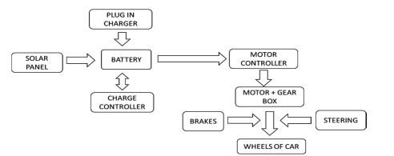
Block Diagram:

Slide 6
Advantages:
• Cost- effective
• Eco friendly
• Absence of carbon emission
• Fossil fuel- free vehicle
• Reduces noise pollution

Slide 7
Conclusion:
In order to cope with the increasing demands for fuel and the disastrous environment pollution due to driving carbon-based vehicles, it is quite necessary to switch to a new source of energy, i.e. the solar power which would be a cheap, efficient, limitless and of course an eco-friendly alternative.
Solar-powered electric vehicles are safe with no volatile fuel or hot exhaust systems.
They are zero emission vehicles, odorless, smokeless and noiseless.

